Slide 1

SYNC+3.0 (Phase5) SW Dev Critical Path
Roger Xu, Jiajia Zhou
Date: July 13, 2021
Desired Outcome
Awareness
Decision
Escalation Help
Think
Point of view
Plan to Implement
Implement

Slide 2
Phase5 SYNC+ 3.0 Timeline Draft To Be Reviewed
1 | 2 | 3 | 4 | 5 | 6 | 7 | 8 | 9 | 10 | 11 | 12 | 1 | 2 | 3 | 4 | 5 | 6 | 7 | 8 | 9 | 10 | 11 | 12 | 1 | 2 | 3 | 4 | 5 | 6 | 7 | 8 | 9 | 10 | 11 | 12
Key Checkpoint
1. Supplier Sourced (SOBD)
======
1.Bill of feature(MFL) Finalized
2.Platform feature spec complete and cascaded
3.Function Safety Concept updated and completed
4.Cybersecurity Requirements Identified
5.UX(UEUI) alignment confirmed
6.SW environment and baseline Design
1.DCV Beta verified supporting Pre-DV/EMC, critical function including Climate/Camera/Radio/Music/Video/Navigation/Speed meter/Driving Info etc.
2.Feature Software early system-level integration test start at <FDJ> breadboard
3. UX doc sign off by HMI/Studio team
1All design verification testing completed by <PEC>
2.Feature Software system-level integration test complete and sign off by feature owner and HMI team
3.R00 release for <PEC> without critical blocker issue,
4.Diagnostics Part2 DV(iTV) test report shows 100% passed
1.Bill of feature Initialized(MFL)
2.Feature Owner confirmation
3. Basic Level spec are available
1. Agile feature full function Integration without critical bug.
1. Software OTA window preserved post Job1 and before OKTB.
1. Platform feature spec finalization and sign off
2.Simulate feature integration of interfaces, states and responses to requested behavior
3. Early test of new and C/O features with physical parts
1.DCV1 verified supporting DV/EMC/DCV MRD with full DCV-must-have fundamental function code completed.
2.Feature Software early system-level integration test complete by <DCV> breadboard, verify feature functionality and performance requirements.
Project VPP
UPV1
UPV2
PA
FDJ
DCV
PEC
FEC
TT
PP
MP1
MP2
PS/PSC
UPV0
OKTB
UX Release
6 weeks
Group A UI
For Pre DV/FDJ
Group B UI
For Critical DV/DCV
Group C UI
For DCV
Group D UI
For DCV/PEC
DCV Critical Path * 45 weeks
>=14 weeks
>=30 weeks
Group A Features Coding based on UI
DCV Alpha
DCV Beta
test
Eng Version
DCV0
test
A1
Pre DV
Hardware
Debug
B0
Critical DV
A0 PCBA
A1 Sample
B0 Sample
B1 Sample
17 weeks(4 months)
4 weeks
5 weeks
>=6 weeks
9 weeks
9 weeks
9 weeks
>=6 weeks
GPDS SW Version for MRD
DCV
DCV Beta
DCV0
DCV1
DCV MRD
R00
R05
R06
R07
R04
R08
Display light up
Platform Arch design
PIPELINE Design
Features and HMI Design
Initial release for Pre DV
DCV Beta
30% Coding
Release Fundamental features for DCV vehicle testing
DCV1
60% Coding
Zero IG defects supporting PEC sign off
R00
95% Coding(Not including Agile features)
Delivery of all features with zero G issues
R05 100% Coding
AIMS Issue solve / Bug fix
R06 100% Coding
AIMS Issue solve / Bug fix
R07 100% Coding
Hotfix for OKTB
10weeks(2.5months)
8weeks(2months)
17 weeks(4months)
17 weeks(4months)
13 weeks(3months)
8weeks(2months)
9 weeks(2months)
Preserved

Slide 3
SYNC+ 3.0 DCV/PEC/J1 Critical Path
China Accelerated SW Plan ---DCV Critical Path
45 weeks
Group A UI Release
FDJ
DCV
Group A Features Coding based on UI
DCV Beta 30%
DCV0 50%
DCV1 60%
DCV Alpha
DCV Beta
Test
A Sample
Pre DV
Debug
B Sample
Critical DV
MRD
Display light up
Platform Arch design
PIPELINE Design
Features and HMI Design
Initial release for Pre DV
DCV Beta
30% Coding
Release Fundamental features for DCV vehicle testing
DCV1
60% Coding
10weeks(2.5months)
8weeks(2months)
17 weeks(4months)
China Accelerated SW Plan ---PEC/J1 Critical Path
4 weeks
5 weeks
6 weeks
6 weeks
9 weeks
9 weeks
9 weeks
DCV
DCV
PEC
FEC
TT
PP
J1
OKTB
DCV1
DCV MRD
R00 95%
R04
R05 100%
R06
R07
R08
Zero IG defects supporting PEC sign off
R00 (4*SW iterated versions )
95% Coding(Not including Agile features)
Delivery of all features with zero G issues
R05 100% Coding for TT MRD
AIMS Issue solve / Bug fix
R06 100% Coding for PP MRD
AIMS Issue solve / Bug fix
R07 100% Coding for J1
Hotfix for OKTB
R08 100% Coding
17 weeks(4months)
13 weeks(3months)
8weeks(2months)
8 weeks(2months)
Preserved

Slide 4
Backup material

Slide 5
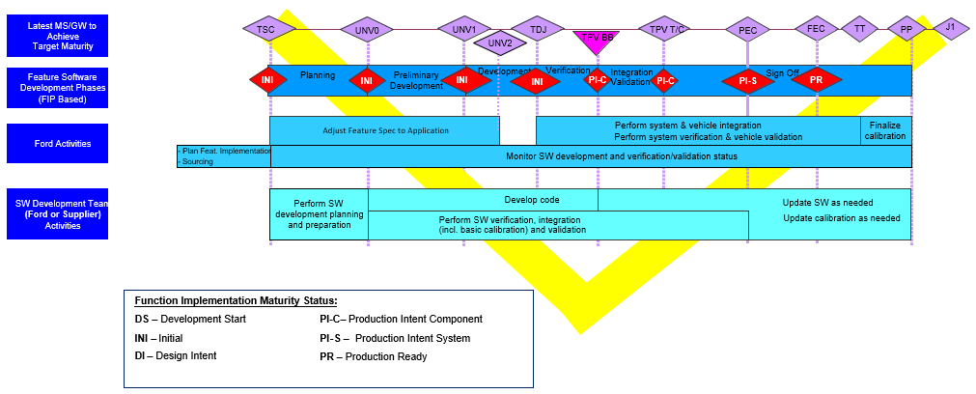
GPDS Function Implementation Maturity V Chart

Slide 6
SW Release Schedule Requirement for MRD
CDX707
R-Event | Software Maturity | Corresponding Milestone | Release Due Date^{*1)} | Build Support
TPB | Fully verified on component level | TPV BB MRD - 1 week | 9/9/2019 | Support TPV BB and TPV T&C MRD
TP3 | Updates Release | TDC - 2weeks | 1/22/2021 | Support TDC
DCV beta | System test on engineering prototype | eBB MRD | 8/20/2021 | Support FDJ
DCV 0 | Fully verified on component level | DCV BB MRD - 4 weeks | 11/10/2021 | Support <DCV BB> MRD and HiL MRD
DCV 1 | Updates Release | T/C MRD - 4 weeks | 12/8/2021 | Support <T/C> MRD
DCV 2 | Updates Release | DCV - 2 weeks | 1/19/2022 | Breadboard update, DCV vehicles update
DCV 3 | Updates Release | DCV+ 4 weeks | 3/2/2022 | Breadboard update, DCV vehicles update
R00 | Feature DV complete. | PEC - 6 weeks | 5/2/2022 | DCV vehicles update for PEC Sign-off
R04 | Feature DV signed off | FEC - 6 weeks | 6/13/2022 | DCV vehicles update for FEC Sign-off
R05 | Fully Validated Release | TT MRD - 4 weeks | 7/13/2022 | Support <TT> MRD
R06 | Fully Validated Release | PP MRD - 4 weeks | 9/28/2022 | Support <PP> MRD
R07 | Fully Validated Release | MP1/J1 MRD - 4 weeks | 12/6/2022 | Support <MP1> MRD
CX788
R-Event | Software Maturity | Corresponding Milestone | Release Due Date*1) | Build Support
TPB | Fully verified on component level | TPV BB MRD - 1 week | NA | Support TPV BB and TPV T&C MRD
TP3 | Updates Release | TDC - 2weeks | 7/30/2021 | Support TDC
DCV beta | System test on engineering prototype | eBB MRD | 1/7/2022 | Support FDJ
DCV 0 | Fully verified on component level | DCV BB MRD - 4 weeks | 3/21/2022 | Support <DCV BB> MRD and HiL MRD
DCV 1 | Updates Release | T/C MRD - 4 weeks | 5/4/2022 | Support <T/C> MRD
DCV 2 | Updates Release | DCV - 2 weeks | 5/30/2022 | Breadboard update, DCV vehicles update
DCV 3 | Updates Release | DCV+ 4 weeks | 7/11/2022 | Breadboard update, DCV vehicles update
R00 | Feature DV complete. | PEC - 6 weeks | 9/2/2022 | DCV vehicles update for PEC Sign-off
R04 | Feature DV signed off | FEC - 6 weeks | 10/12/2022 | DCV vehicles update for FEC Sign-off
R05 | Fully Validated Release | TT MRD - 3 weeks | 11/24/2022 | Support <TT> MRD
R06 | Fully Validated Release | PP MRD - 4 weeks | 1/26/2023 | Support <PP> MRD
R07 | Fully Validated Release | MP1/J1 MRD - 4 weeks | 4/1/2023 | Support <MP1> MRD

Slide 7
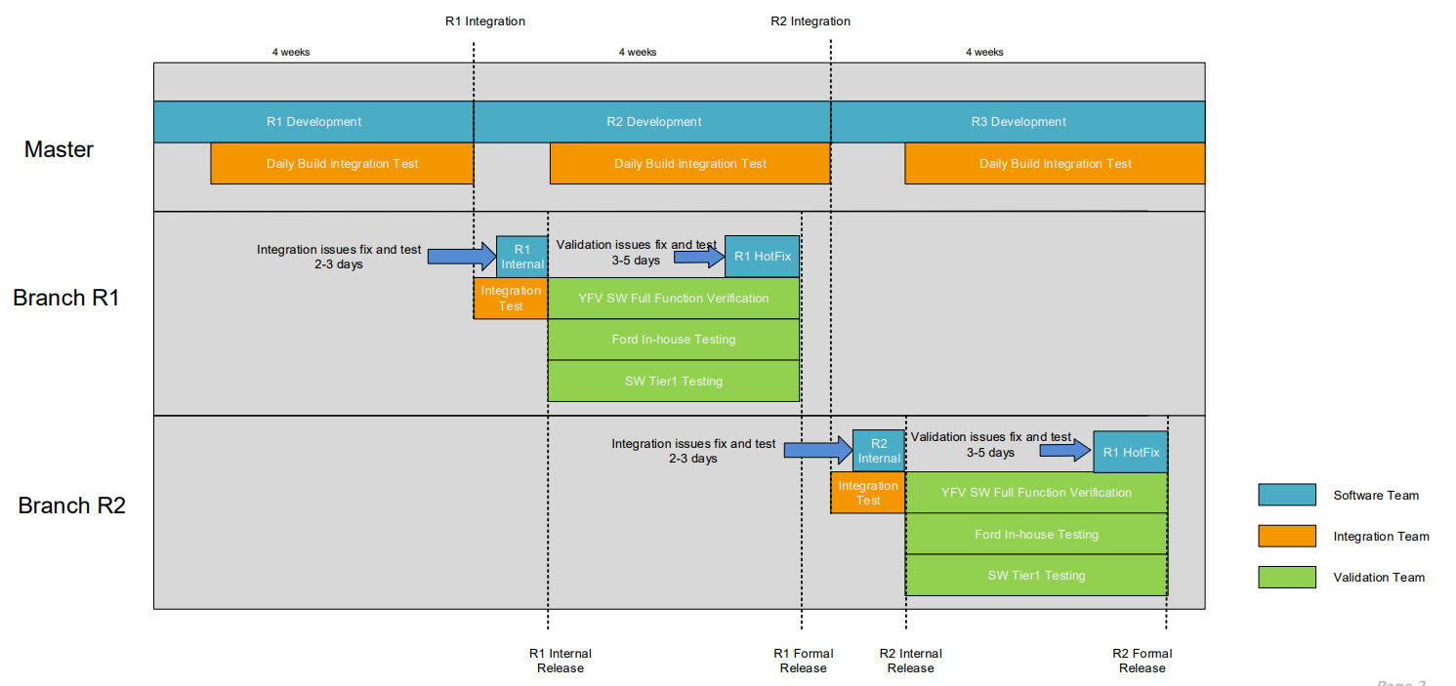
Phase5 SW Integration and Release Rule
2021 | 2022 | 2023
Checkpoint2:
Eng SW Release for REC
Checkpoint1:
Vendor Integration
Checkpoint3:
Pro SW Release for CAF/FO

Slide 8
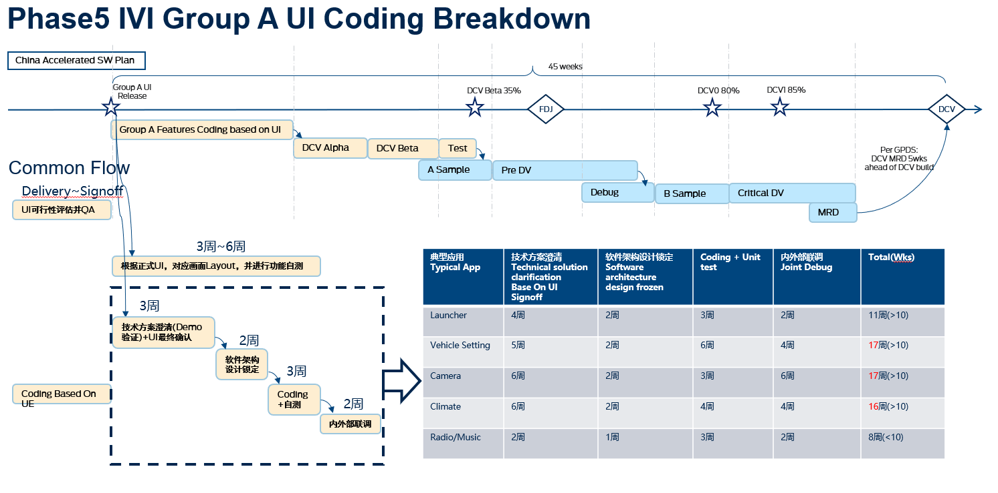
IVI Group A UI -> DCV1 Release Critical Path
Hardware DV Critical Path
Full DV (3 Months) : E-412 Group A-F 6 legs (12Wks), Refer to attachment for Details
Pre-DV(2 Months) : 60% Of Full DV Content 2 Months ( Longest leg Group A)
Critical DV: EMC (45 days), considering Facility setup& Debug & reporting, 2months
Software Critical Path To Support PreDV From Group A HMI Delivery

Slide 9
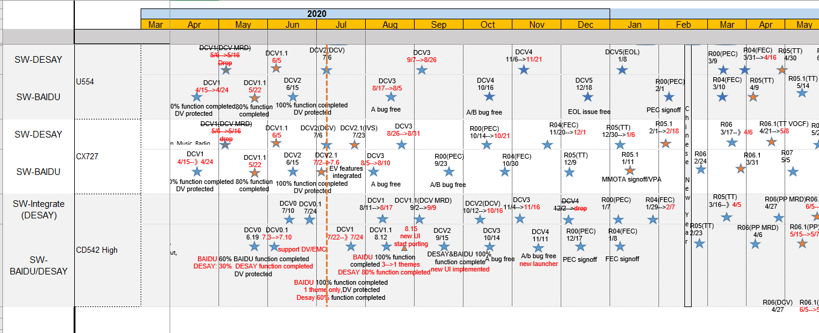
Phase4 SW Release Duration from DCV1->R00
2021 | 2022 | 2023

